Slide 1


Strategies, Opportunities, and Applications of Generative AI
Generative AI is transforming how we create, innovate, and interact with technology. It's a powerful force driving digital transformation across industries.
by Jayesh Sharmila

Slide 2
Defining Generative AI
What is it?
How does it work?
Generative AI models learn from data and generate new outputs, like text, images, audio, and code.
It uses deep learning algorithms, including transformers and variational autoencoders, to understand patterns and generate new content.

Slide 3
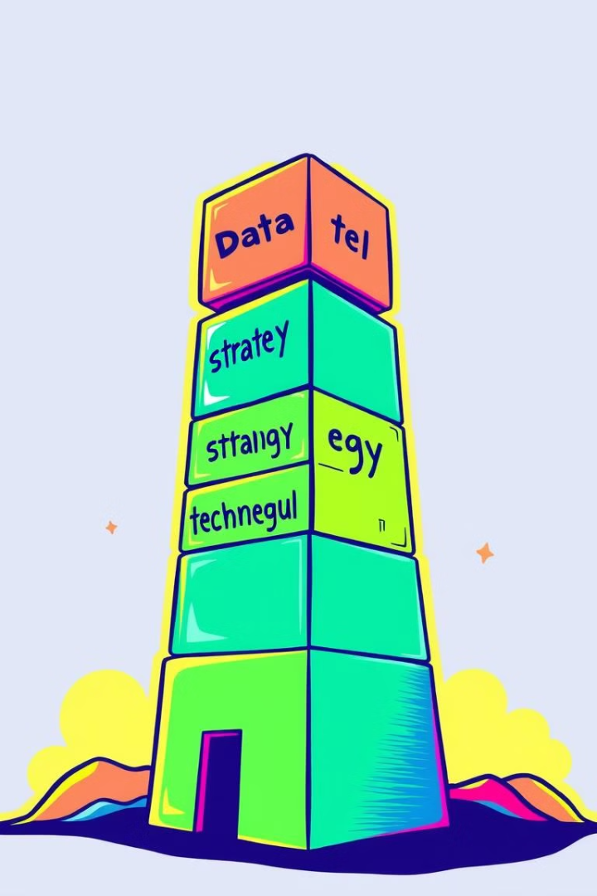
Key Pillars of an Effective Generative AI Strategy
Data
Strategy
High-quality, relevant data is essential for training effective generative AI models.
A clear strategy outlines goals, use cases, and potential risks, guiding AI development and deployment.
Technology
Governance
Choose appropriate generative AI models and tools based on your needs and resources.
Establish responsible AI principles and ensure ethical considerations are integrated into all AI projects.

Slide 4




Assessing Organizational Maturity for Generative AI
Initial Exploration
1
Understanding the basics of generative AI and its potential benefits.
2
Pilot Projects
Testing generative AI models in specific use cases to gather insights and feedback.
3
Strategic Implementation
Integrating generative AI models into core business processes and workflows.
Advanced Implementation
4
Developing custom models and solutions for specific business challenges.

Slide 5
Technical Infrastructure and Data Governance Considerations
Infrastructure
Data Governance
Generative AI models require significant computational resources and specialized hardware, such as GPUs.
Implement robust data governance practices to ensure data security, privacy, and ethical use.

Slide 6




Talent and Upskilling for Generative AI Adoption
Upskilling
Talent Acquisition
Collaboration
Provide training programs for employees to understand generative AI concepts and applications.
Hire skilled data scientists, AI engineers, and domain experts to build and manage generative AI systems.
Foster a culture of collaboration between AI experts and business stakeholders.

Slide 7
Identifying Business Opportunities for Generative AI
Customer Experience
1
Personalized recommendations, content creation, and AI-powered chatbots.
Product Development
2
Accelerated design, prototyping, and optimization using generative AI tools.
Operational Efficiency
3
Automating repetitive tasks, improving data analysis, and optimizing workflows.

Slide 8



Applications of Generative AI Across Industries
Healthcare
Manufacturing
Finance
Drug discovery, personalized medicine, and medical imaging analysis.
Predictive maintenance, automated quality control, and intelligent design.
Fraud detection, investment analysis, and personalized financial advice.

Slide 9

Navigating the Ethical Considerations of Generative AI
1
2
Bias
Privacy
Address biases in training data and models to ensure fairness and equity.
Protect user data and privacy while using generative AI models.
3
4
Transparency
Safety
Make AI decision-making processes transparent and explainable.
Develop safeguards to prevent malicious use of generative AI models.

Slide 10
Implementing a Generative AI Roadmap
Identify key business goals and use cases for generative AI.
1
2
Develop a pilot project to test and evaluate generative AI models.
Scale and integrate generative AI models into core business processes.
3
4
Monitor and evaluate the performance of generative AI models over time.
Continuously iterate and improve generative AI models based on feedback and new data.
5

